Slide 1
HOSPITAL MANAGEMENT SYSTEM
Project: Hospital Management System
Team: H. Blessy Jefrina (2553002)
Mentor: Dr.G.SivakamaSundari
Dept: Information & Cyber Warfare
Date: 10/12/2025 – FINAL REVIEW

Slide 2
Problem Statement
Hospitals often rely on traditional management systems that suffer from slow data retrieval, poor integration between modules, and high dependence on manual processes. These limitations lead to delays in accessing, inefficient appointment scheduling, errors in billing, and overall reduced operational efficiency.

Slide 3
Objectives
The primary objectives of a Hospital Management System are to automate and streamline hospital processes, ensure accurate patient and to book appointment improve patient care and safety, manage resources efficiently, and support better decision making through timely reports and analytics.

Slide 4
Literature Review / Existing Systems
Traditional hospital systems are slow, redundant, and poorly integrated. Studies emphasize the need for modular, efficient designs using data structures like hash tables, heaps, and indexed lists. Our system resolves these issues through optimized Python data structures combined with Django framework andSQLite3 for faster, reliable operations.

Slide 5
Methodology
The system uses a web UI (HTML/CSS/JS) connected to Django , Python backend logic with SQLite3 storage. It includes modules for patients, appointments, staff, billing, records, and inventory. Efficient data structures and algorithms like hash search, priority queue scheduling and tries to optimize performance.

Slide 6
Implementation Details
Core modules
Patient module — patient profiles, demographic and contact data,
Appointment engine — efficient scheduling and booking management.
Doctor module — Doctor profiles, demographic and appointment

Slide 7
DATA STRUCTURE USED
Queue – Patient Queue
Patient Queue is used to manage patients in a First-Come-First-Served order, ensuring fair and organized appointment flow. It helps the hospital system simulate real waiting-room behavior where the next patient is always served from the front of the queue.
Hash Table – Patient Record Table
Patient Record Table uses a hash table to store and retrieve patient records instantly using a unique patient ID as the key. This allows the hospital system to access patient information in constant time, improving efficiency compared to searching through full lists.

Slide 8
DATA STRUCTURE USED
HEAP
The system uses a min-heap to prioritize urgent patients by automatically placing the highest-priority cases at the top. Internal heap functions such as heapify(), heap push(), and heap pop() maintain this priority structure efficiently during every update.
Tries – Autocomplete
Patient Tries uses a prefix-based tree structure to store patient names so the system can quickly suggest matches as the user types. Its autocomplete capability helps staff find patient records faster, even when only partial names are entered.

Slide 9
Tools and Technologies
Programming Language: Python with Data Structures
Framework: Django
Database: SQLite
Front End : HTML5, CSS3 , JS
IDE: Visual Studio Code

Slide 10
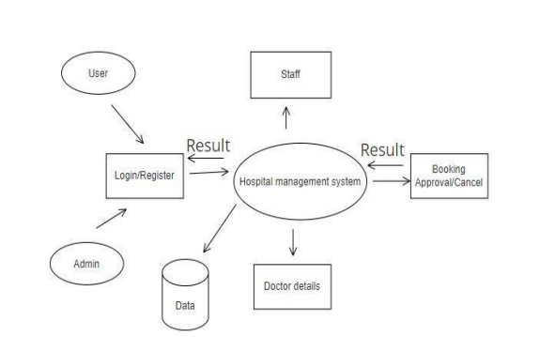
SYSTEM ARCHITECTURE

Slide 11
Demonstration
Appointments - Appointment slots auto-generated from doctor availability.
Medical Blogs – To Follow Healthy Lifestyle
Dashboard - Real-time metrics and summaries.
Role-based access - Separate login views for Patient and Doctor.

Slide 12
Results & Analysis
The system delivers fast data lookup, optimized scheduling, and a responsive user interface.
The Hospital Management System streamlines patient handling by using efficient data structures for faster processing and improved organization.
Overall, HMS delivers a more reliable, faster, and smarter healthcare workflow compared to manual systems.

Slide 13
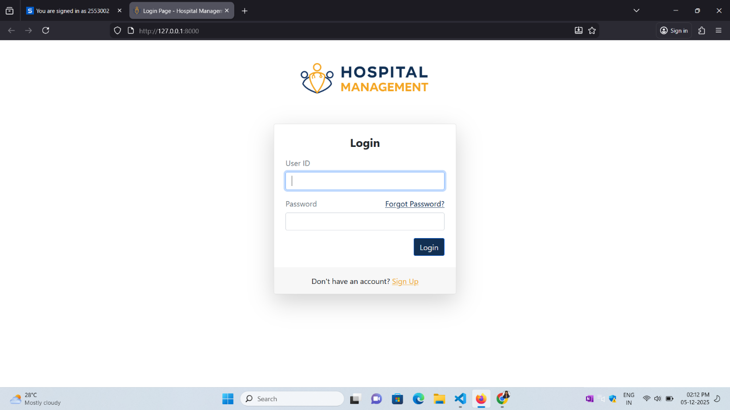
RESULT & ANALYSIS

Slide 14
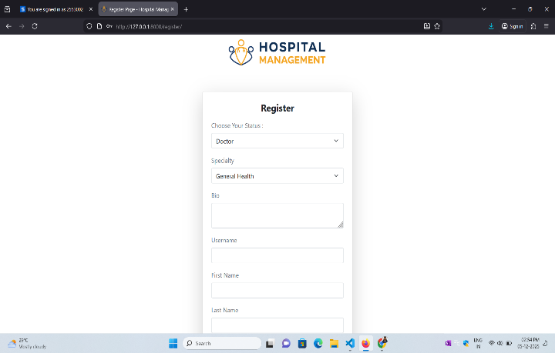
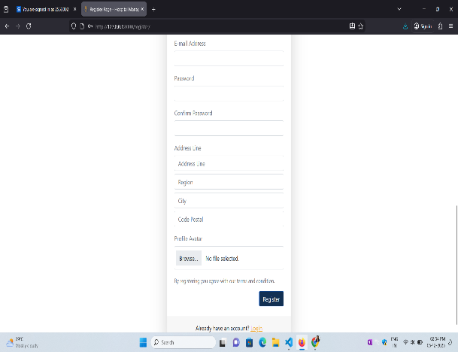
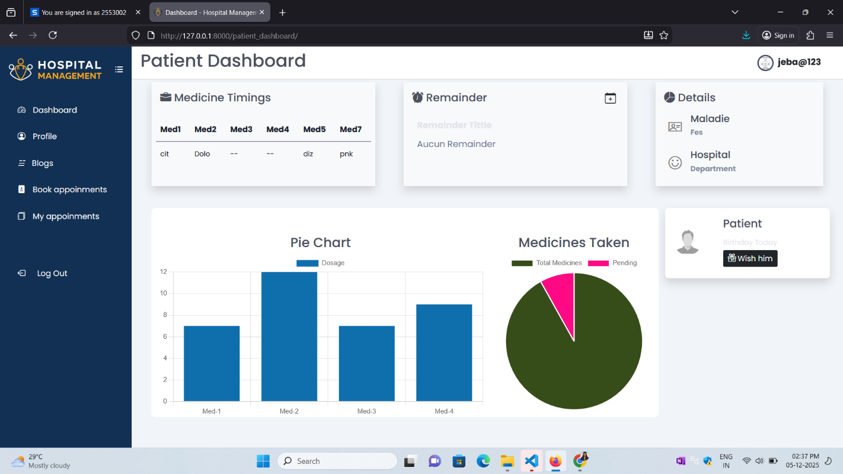
RESULT

Slide 15
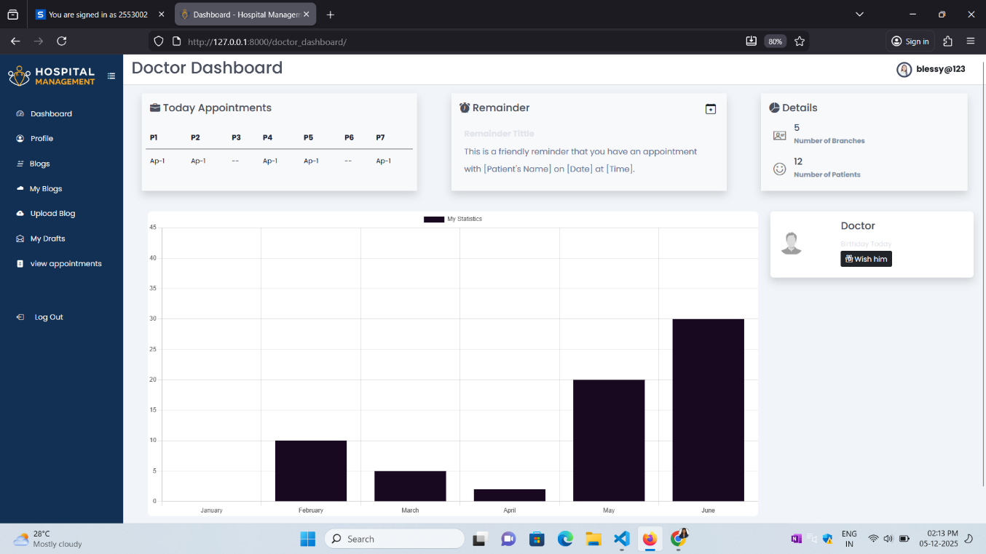
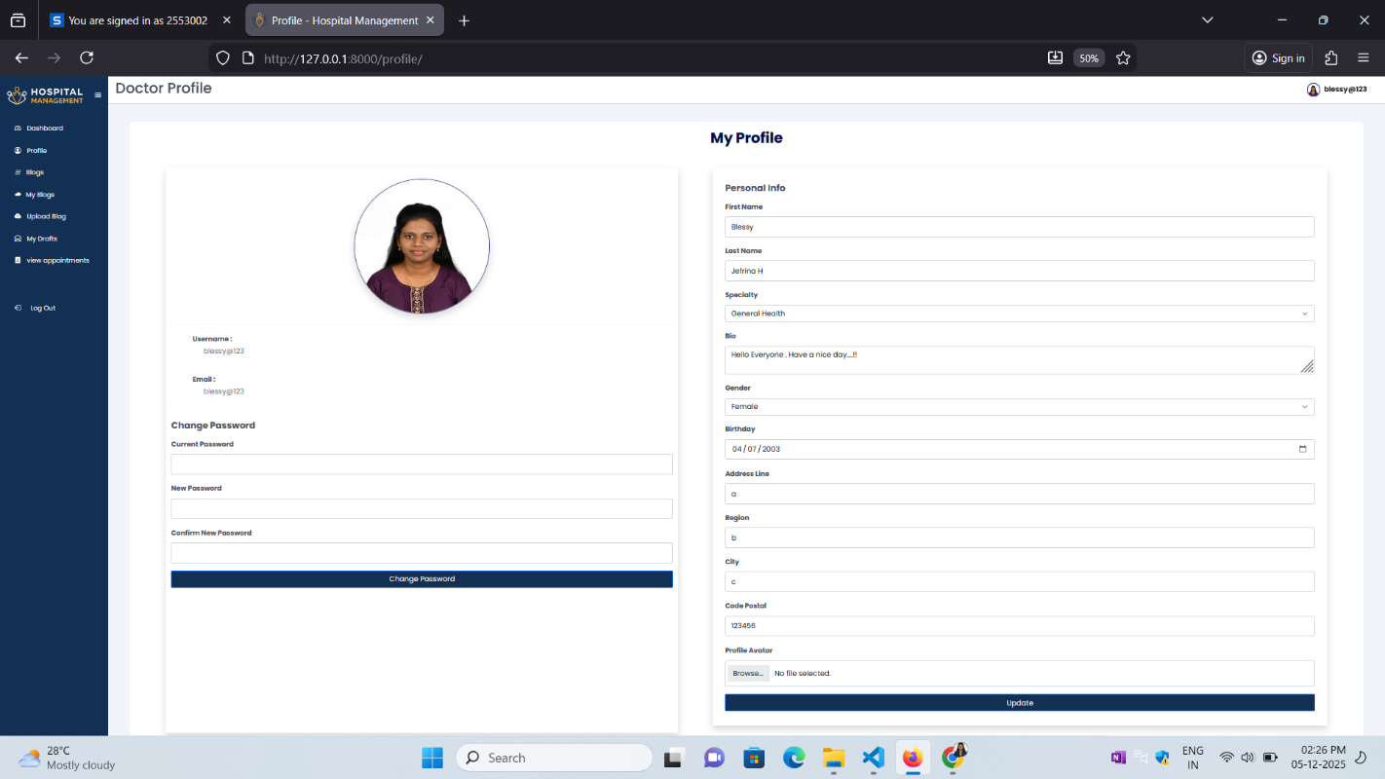
RESULT

Slide 16
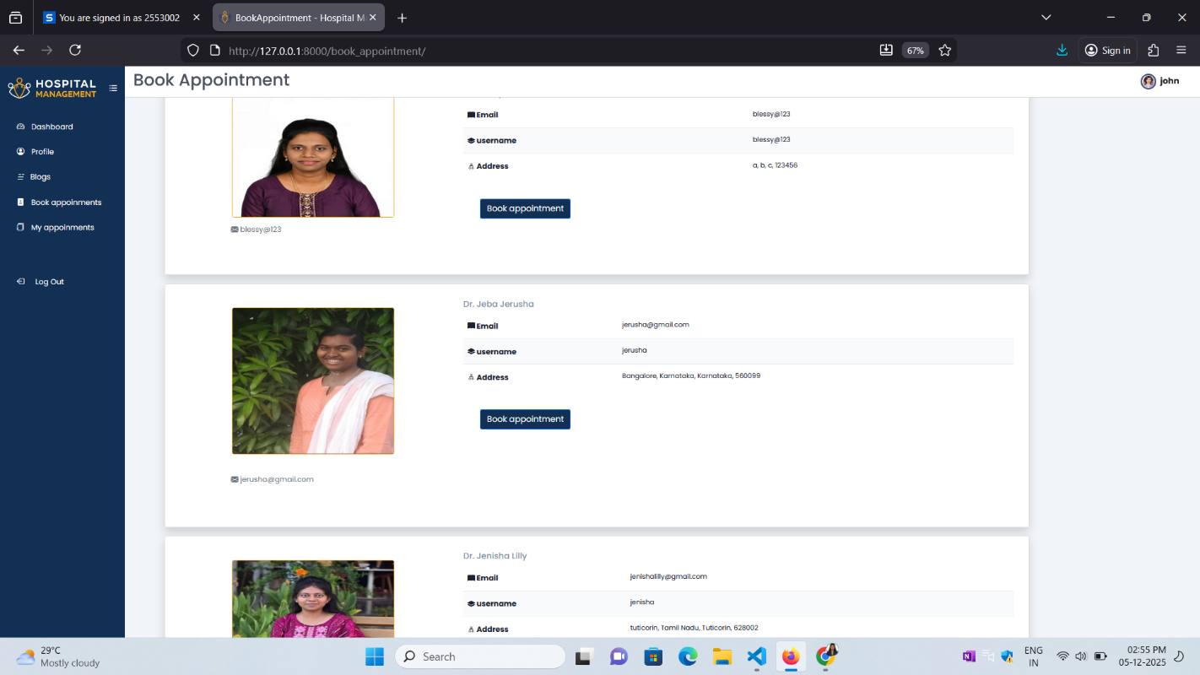
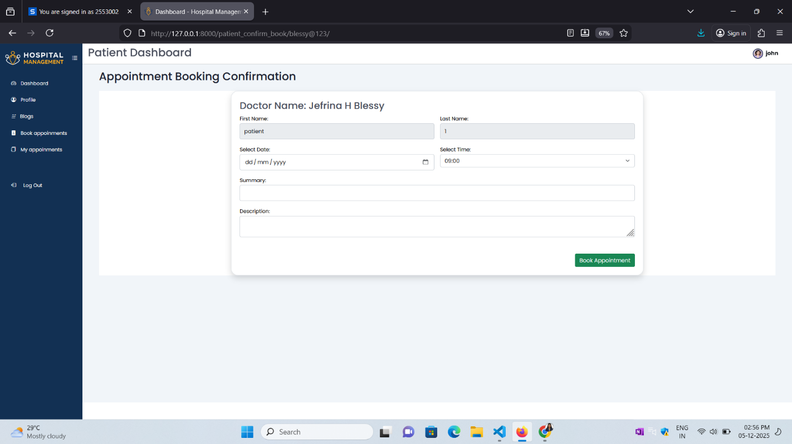
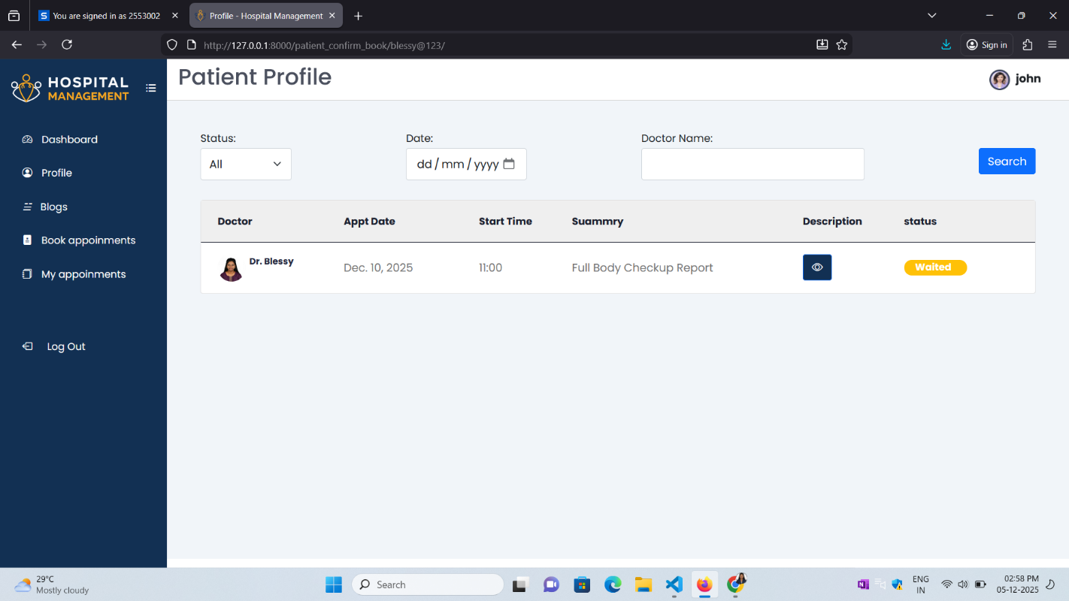
RESULT

Slide 17
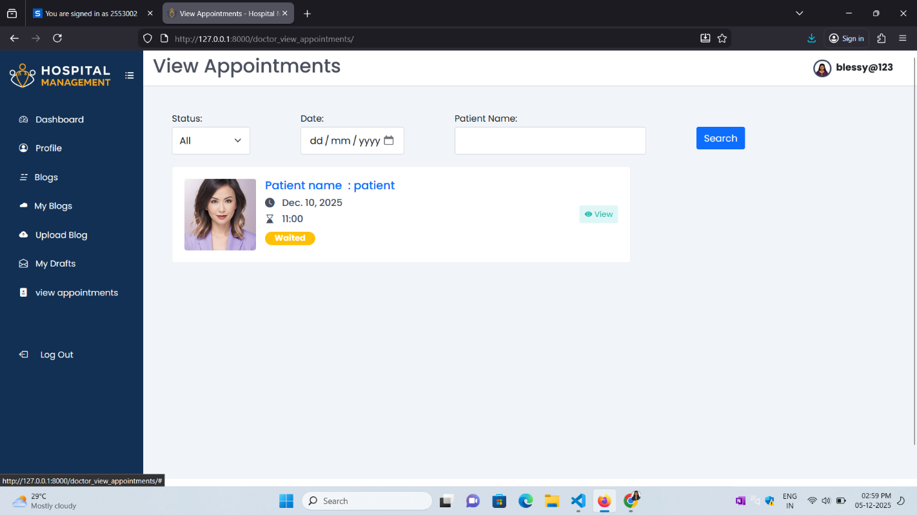
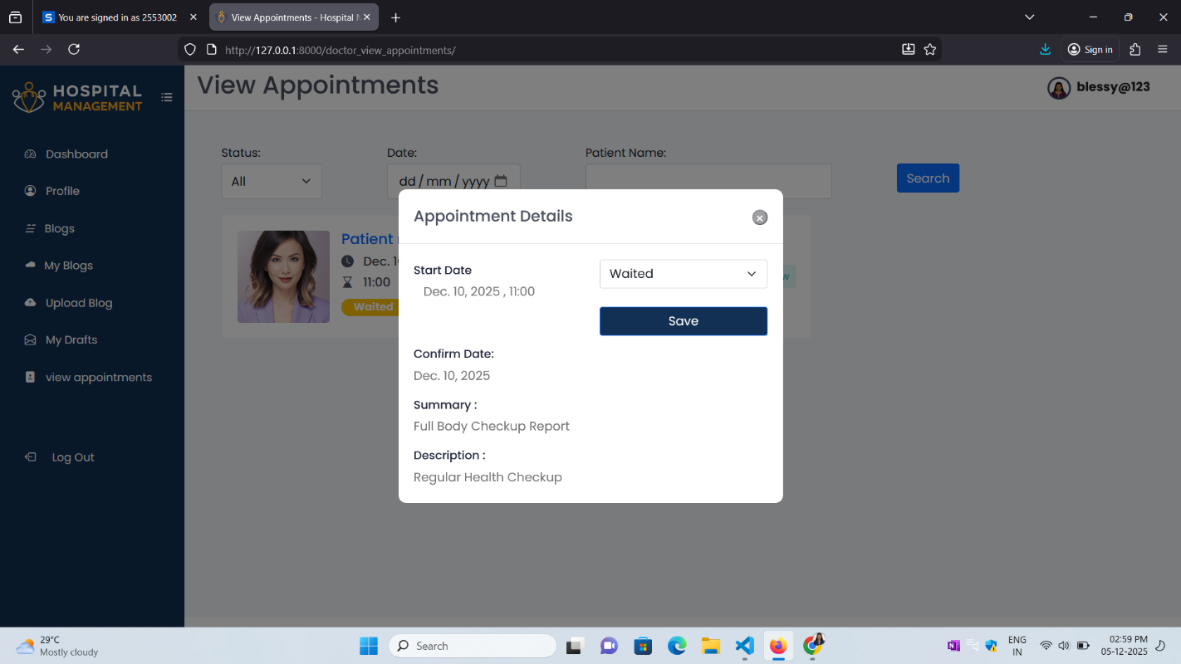
RESULT

Slide 18
Future Enhancements
Cloud integration - Scalable data storage and real-time access.
Predictive analytics - Forecast patient flow, inventory needs and scheduling demand.
Mobile application - For on the go access by patients and staff.
Full backend with advanced authentication - secure, role-based operations.
Blood bank Modules – To request Blood and for Blood Donor

Slide 19
Conclusion
The Hospital Management System successfully integrates advanced data structures with Python and the Django framework to deliver a faster, smarter, and more organized healthcare workflow. Data structures such as queues, hash tables, heaps, and tries enhance the system’s efficiency by improving patient flow, accelerating record retrieval, prioritizing emergencies, and enabling intelligent search features. Django provides secure backend handling and smooth database management, while HTML, CSS, and JavaScript ensure a clean, responsive, and user-friendly interface. Together, these technologies create a reliable, scalable, and modern HMS that significantly outperforms traditional manual hospital processes.

Slide 20
REFERENCES
• Mark Allen Weiss – DS & Algorithms
• Healthcare Data Management papers
• Geeks for Geeks / W3Schools
Dückers, Michel, et al. "Longitudinal analysis on the development of hospital quality management systems in the Netherlands
Balaraman, Premkumar, and Kalpana Kosalram. "E-Hospital Management & Hospital Information Systems-Changing Trends.

